Slide 1

Akrivia Health / Global Minds Proteomics Update
Julie Segueni, PhD, Bioinformatics
Kevin Blighe, PhD, Bioinformatics
Corey Oravetz, CSM, Project Manager​
Shahraz Niwaz, MSc , Business Account Manager
2026-Mar-17

Slide 2
Agenda
Action Items
Bio Updates
Open Q&A / Discussion
Timeline / Gantt
Month 2026
00

Slide 3
Meeting Minutes & Action Items

Slide 4
Action Items
Action Items from 2026-Mar-10 Meeting
Julie: Redo DA analysis and Pathway analysis using Age as covariate – COMPLETED, 2026-Mar-17
Julie: Extract proteins within the ridge plot peaks and plot them on raw abundance heatmaps. - IN PROGRESS​
Julie: Color the volcano plot by identified pathway membership to show distribution of effect sizes per pathway. - COMPLETED, 2026-Mar-17
Julie: Provide new plots showing raw pathway-level abundances using dementia as a reference group across all diseases. - COMPLETED, 2026-Mar-17
Joe: Check-in with Alessandra that the budget and spend are acceptable if the project timeline extends. - COMPLETED, 2026-Mar-17
Action Items from 2026-Feb-24 Meeting
Julie: Pathway analysis from DAA results – COMPLETED, 2026-Mar-09
Action Items from 2026-Mar-17 Meeting
Julie: Julie to consider further analysis during the DAA that can statistically validate the absence of bias effects - COMPLETED, 2026-Mar-17
Julie: Start on the DAA process – COMPLETED, 2026-Feb-23
Action Items from 2026-Feb-10 Meeting
Joe: Joe to reach out to Akrivia to get clarification about the 17 samples labeled as 'other' - COMPLETED, 2026-Mar-17
Joe: Provide Julie with any details about the normalization process that was applied to one of the data files - IN PROGRESS
Joe: Check on the progress of clinical data analysis and share any relevant co-morbidities or self-reported information that might be useful for differential analysis in next week's meeting – IN PROGRESS
Julie: Start on the QC and normalization process – COMPLETED, 2026-Feb-13

Slide 5
Bio Updates

Slide 6
Updated classes using metadata from Joe
Diagnosis | Number of samples
Bipolar disorders | 81
Psychotic disorders | 36 + 2
Depressive disorders | 152 + 5
Dementia | 124 (excluded 1 sample with unknown biological sex)
Schizophrenic disorders | 54

Slide 7
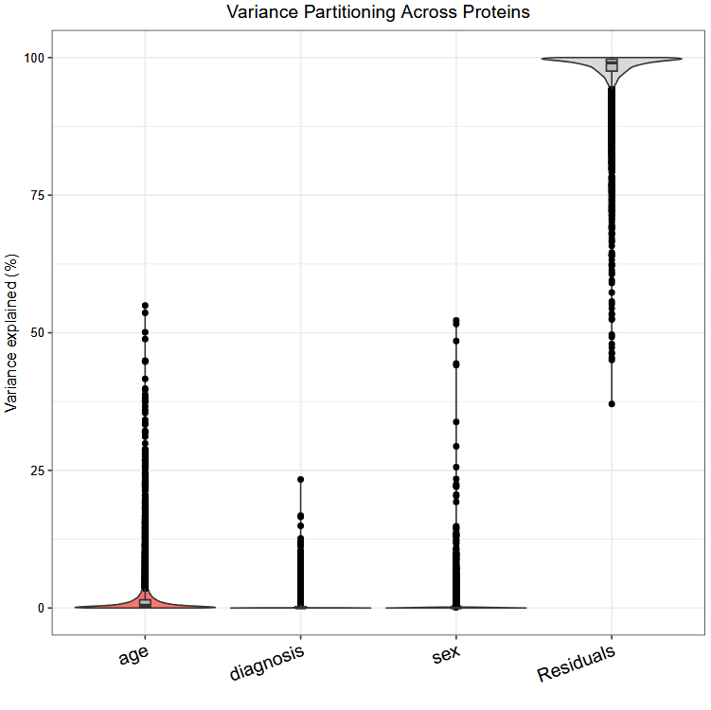
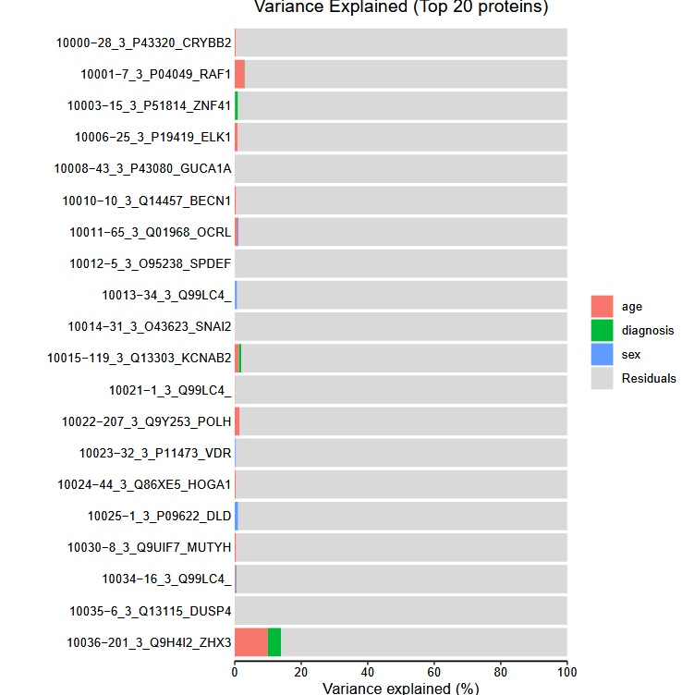
Variance Partitioning Analysis results
Age is a confounder and will be used as covariate for a new DA analysis followed by pathway analysis

Slide 8
Updated DA results
DA analysis results – General results
11k SOMAid from Somascan panel (mapping to 9,535 unique genes)
DA analysis per contrast among the diagnostic classes, adj.pval <=0.05 and |logFC| >= 0.5
After covariate analysis using age
Contrast | Dementia (n = 124 patients) | Depressive disorder (n = 157 patients) | Psychotic disorder (n = 38 patients) | Schizophrenic disorder (n = 54 patients)
Bipolar disorder (n = 81 patients) | 26 DA proteins | 0 DA protein | 0 DA protein | 0 DA protein
Dementia (n = 124 patients) |  | 23 DA proteins | 0 DA protein | 46 DA proteins
Depressive disorder (n = 157 patients) |  |  | 5 DA proteins | 0 DA protein
Psychotic disorder (n = 38 patients) |  |  |  | 0 DA protein

Slide 9
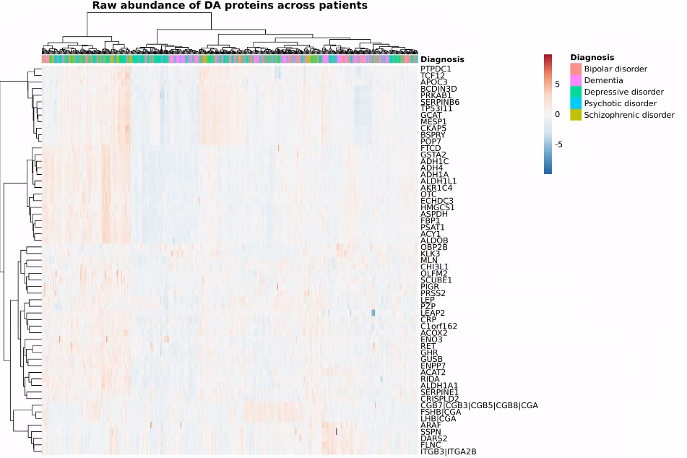
Raw abundances for all diseases based on DA proteins

Slide 10
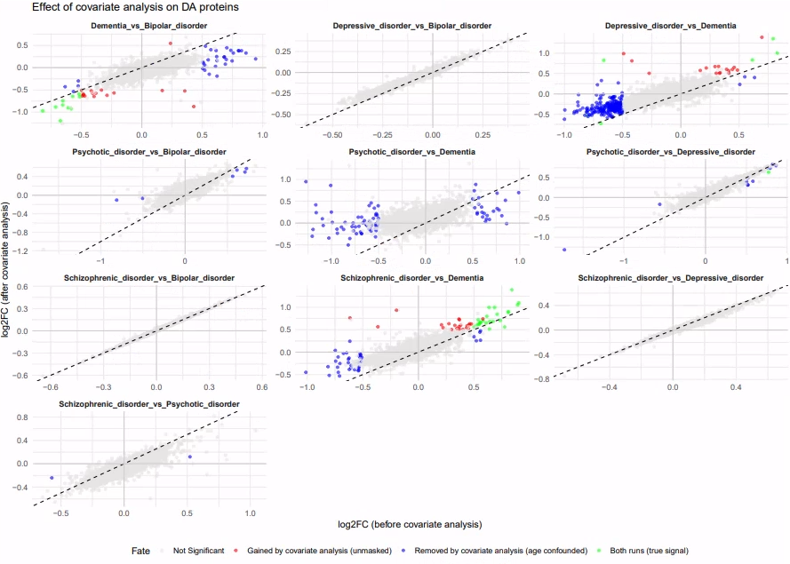
Effect of age covariate analysis on DA analysis
Covariate analysis:
Dementia vs Bipolar disorder: 10 proteins in both runs, 31 removed by covariate analysis, 16 gained
Depressive disorder vs Bipolar disorder: 6 proteins in both runs, 233 removed by covariate analysis, 17 gained
Psychotic disorder vs Dementia: 0 in both run, 81 removed by covariate analysis, 0 gained
Psychotic disorder vs Depressive disorder: 1 in both run, 17 removed by covariate analysis, 4 gained by covariate analysis
Schizophrenic disorder vs Depressive disorder: 23 in both runs, 37 removed by covariate analysis, 23 gained
Schizophrenic disorder vs Psychotic disorder : 0 in both runs, 2 removed by covariate analysis, 0 gained

Slide 11
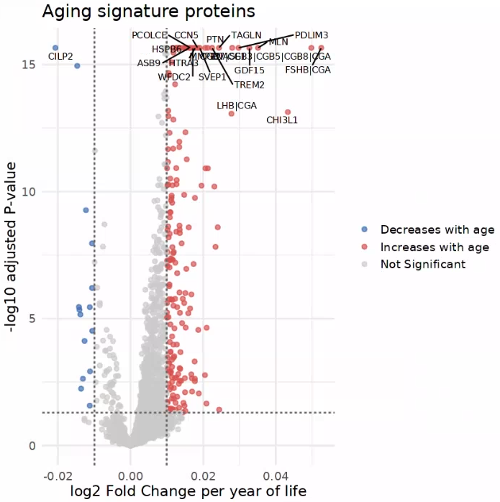
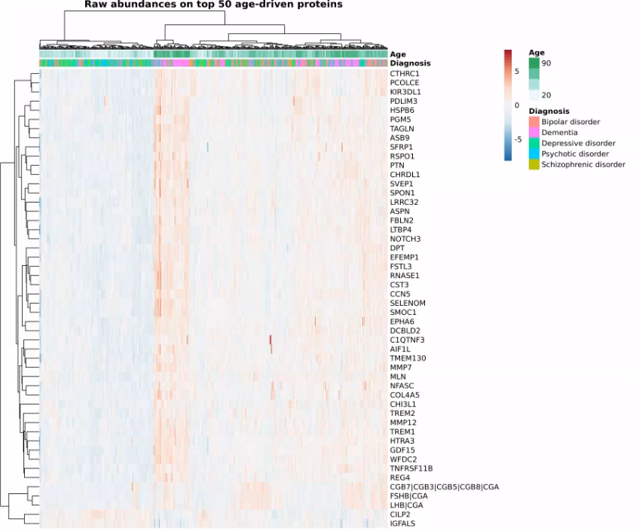
Identification of proteins whose abundance depends on age
We observe significant age-related patterns in these proteins. LogFC is the slope of concentration as a factor of time.

Slide 12
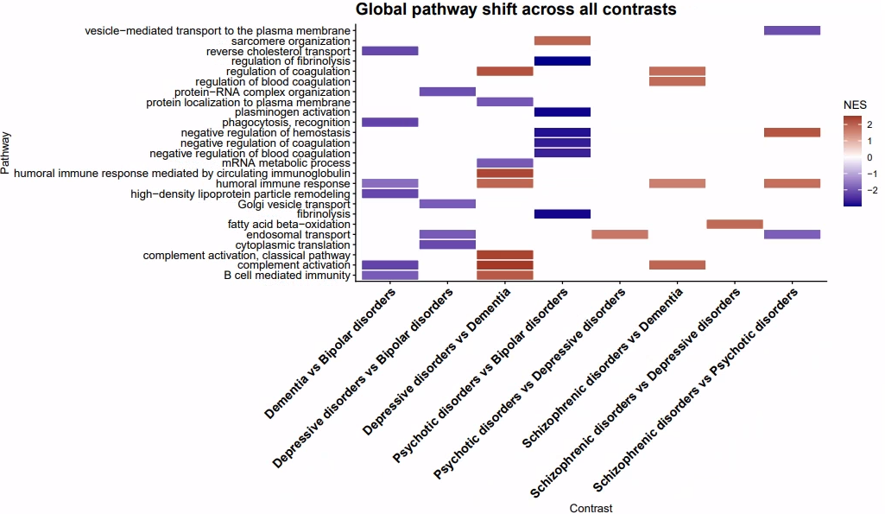
Global pathway analysis results after covariate analysis

Slide 13
Global pathway analysis results after covariate analysis
Pathways upregulated in Bipolar disorders:
Sarcomere organization
Phagocytis recognition
Humoral immune response
High-density lipoprotein particle remodeling
Complement activation
B-cell mediated immunity
Protein-RNA complex organization
Golgi vesicle transport
Endosomal transport
Cytoplasmic translation
Regulation of fibrinolysis
Plasminogen activation
Negative regulation of hemostasis
Negative regulation of coagulation
Negative regulation of blood coagulation
Fibrinolysis
Pathways upregulated in Dementia:
Protein localization to plasma membrane
mRNA metabolic process
Pathways upregulated in Depressive disorders:
Regulation of coagulation
Humoral immune response mediated by circulating immunoglobulin
Humoral immune response
Complement activation, classical pathway
Complement activation
B-cell mediated immunity
Pathways upregulated in Psychotic disorders:
Sarcomere organization
Endosomal transport
Pathways upregulated in Schizophrenic disorders:
Regulation of coagulation
Regulation of blood coagulation
Humoral immune response
Complement activation
Fatty acid beta-oxidation
Negative regulation of hemostasis

Slide 14
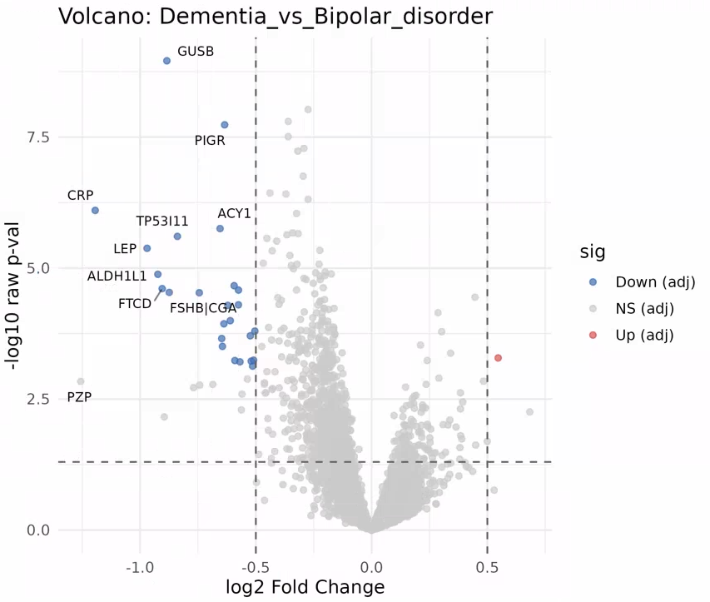
Updated volcano plots after covariate analysis for Dementia vs Bipolar disorder
Dementia vs Bipolar disorder: 26 DA proteins with 25 DA proteins upregulated in Bipolar disorder, 1 DA protein upregulated in Dementia

Slide 15
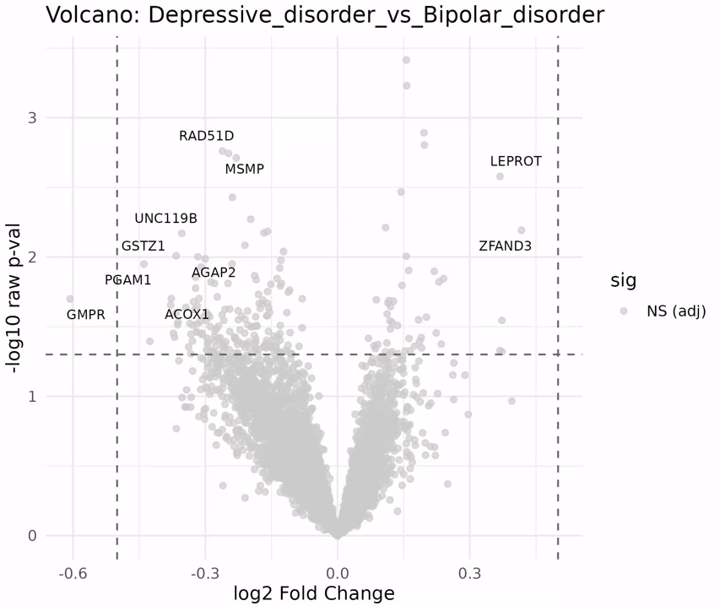
Updated volcano plots after covariate analysis for Depressive disorder vs Bipolar disorder
Depressive disorder vs Bipolar disorder: 0 DA protein

Slide 16
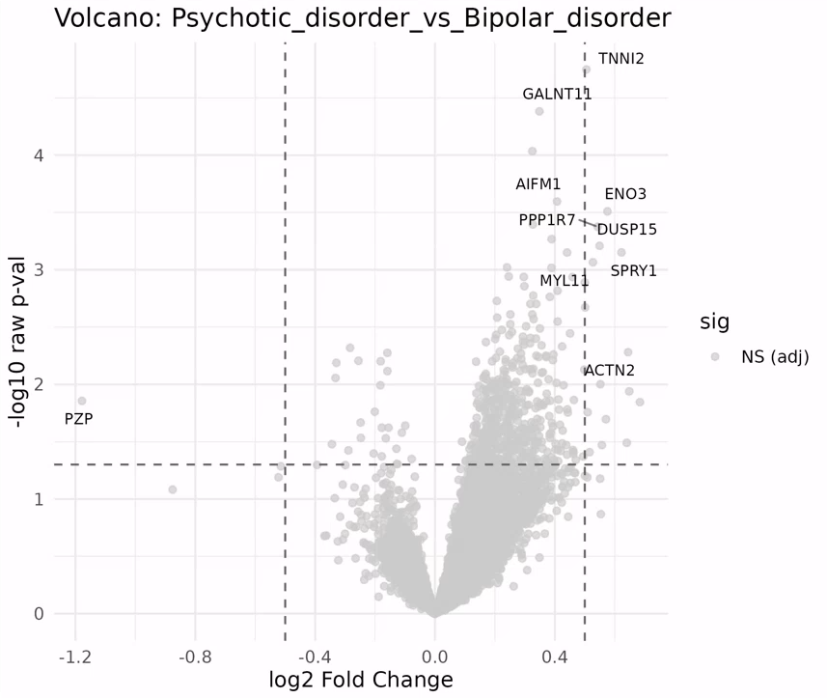
Updated volcano plots after covariate analysis for Psychotic disorder vs Bipolar disorder
Psychotic disorder vs Bipolar disorder: 0 DA protein

Slide 17
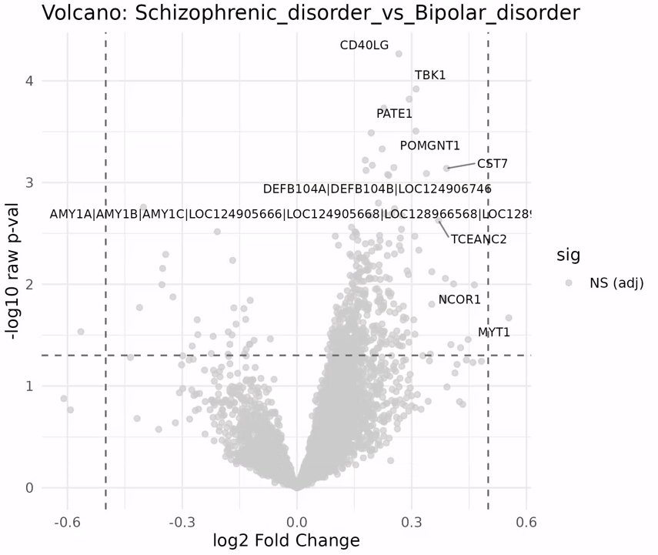
Updated volcano plots after covariate analysis for Schizophrenic disorder vs Bipolar disorder
Schizophrenic disorder vs Bipolar disorder: 0 DA protein

Slide 18
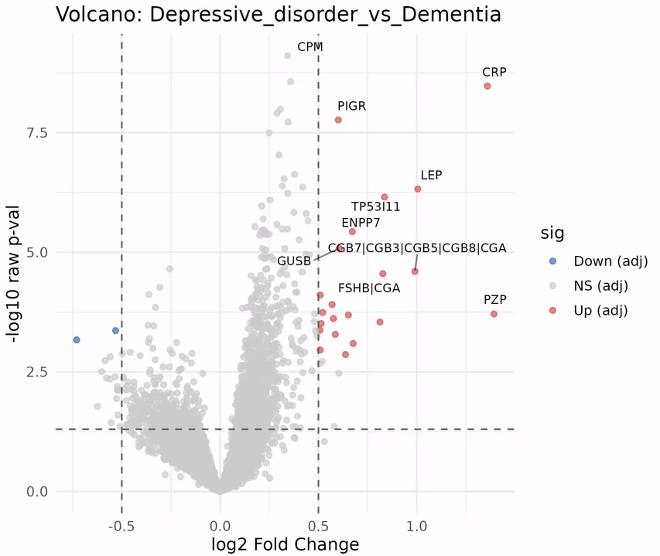
Updated volcano plots after covariate analysis for Depressive disorder vs Dementia
Depressive disorder vs Dementia: 23 DA proteins with 2 DA proteins upregulated in Dementia disorder and 21 proteins upregulated in Depressive disorder

Slide 19
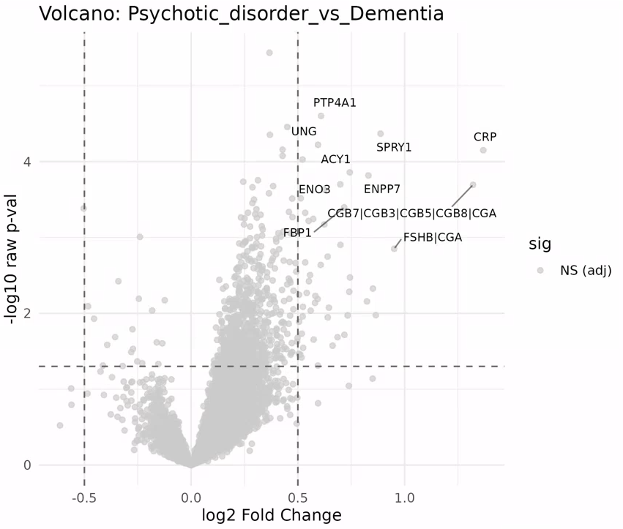
Updated volcano plots after covariate analysis for Psychotic disorder vs Dementia
Psychotic disorder vs Dementia: 0 DA

Slide 20
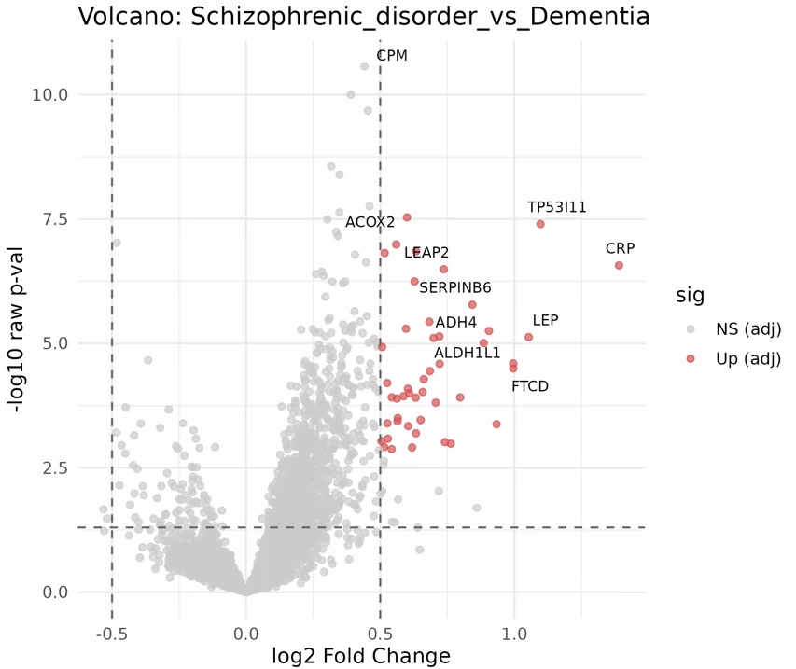
Updated volcano plots after covariate analysis for Schizophrenic disorder vs Dementia
Schizophrenic disorder vs Dementia: 46 DA proteins upregulated in Schizophrenic disorder, 0 upregulated in Dementia

Slide 21
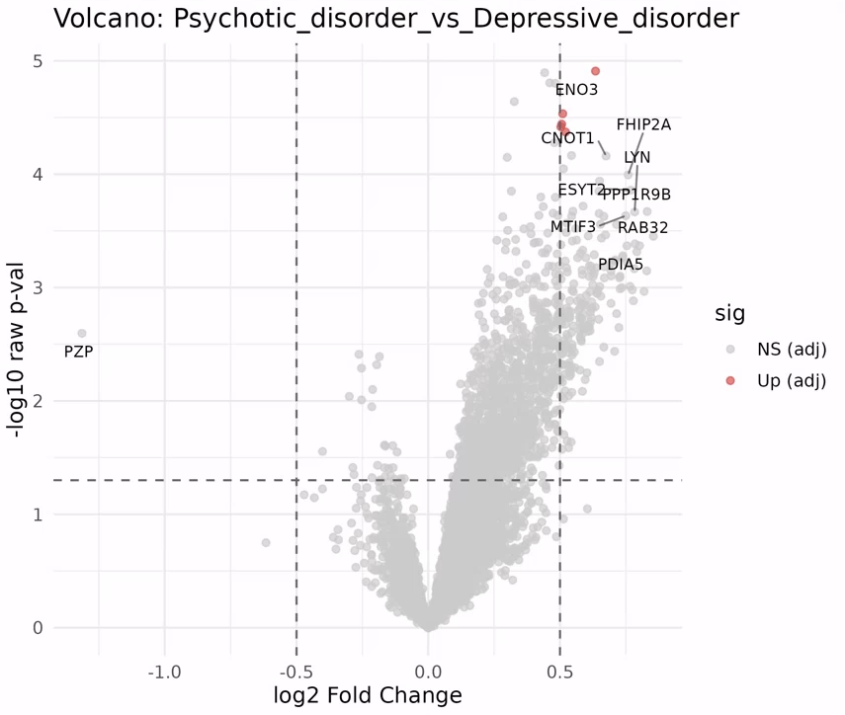
Updated volcano plots after covariate analysis for Psychotic disorder vs Depressive disorder
Psychotic disorder vs Depressive disorder: 5 DA proteins upregulated in Psychotic disorder, 0 upregulated in Depressive disorder

Slide 22
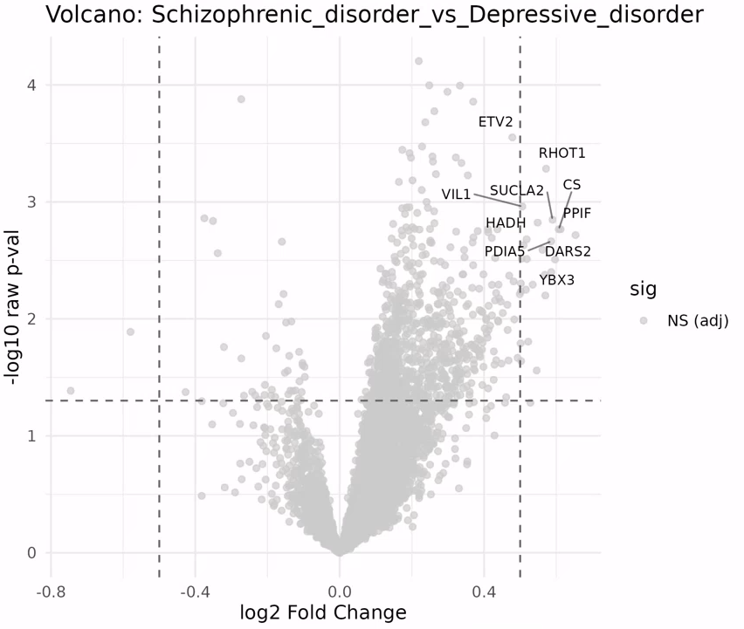
Updated volcano plots after covariate analysis for Schizophrenic disorder vs Depressive disorder
Schizophrenic disorder vs Depressive disorder: 0 DA protein

Slide 23
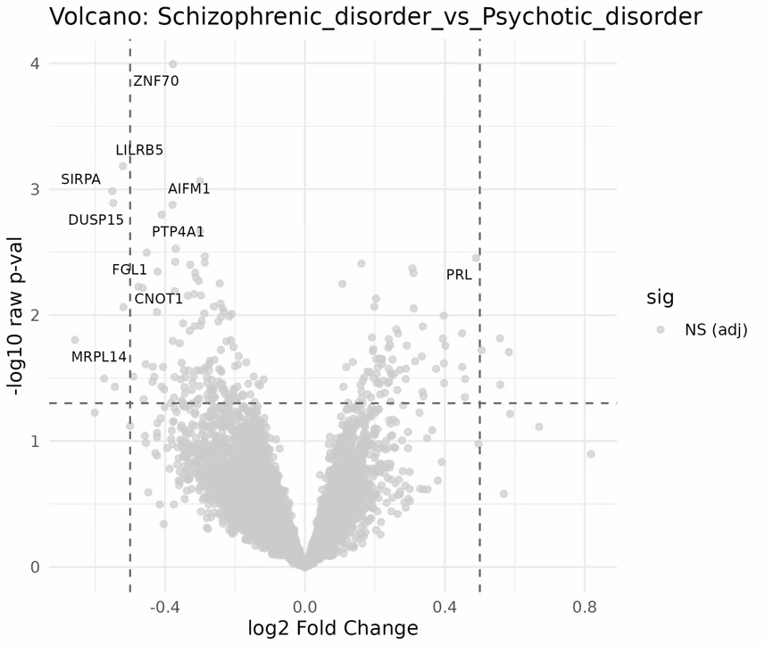
Updated volcano plots after covariate analysis for Schizophrenic disorder vs Psychotic disorder
Schizophrenic disorder vs Psychotic disorder: 0 DA protein

Slide 24
Timeline & Deliverables

Slide 25
J&J: Akrivia Health SomaLogic Proteomics Analysis
Timeline
Today
2026
Feb
Mar
Feb 3 - Feb 9
5 days
Onboarding, Environment Setup, Data Import into Domino
2026
Feb 10 - Feb 13
4 days
Data Normalization & QC
Global Minds / Akrivia Proteomics Analysis
Feb 16 - Feb 23
6 days
Diff Abundance Analysis (DAA)
Feb 24 - Mar 3
6 days
Pathway Analysis
Mar 4 - Mar 9
4 days
Compare Treatment-Resistant Patients vs Reponders
Mar 10 - Mar 12
3 days
Correlate Proteomics Levels to Clinical Data
Mar 13 - Mar 16
2 days
Reporting & QC
Timeline
On-Boarding (4 hours)
Data Retrieval, Normalization, & QC (16 hours)
Differential Abundance Analysis (DAA) (24 hours)
Pathway Analysis (24 hours)
Compare treatment-resistant patients vs responders (16 hours)
Correlate proteomics levels to clinical data (12 hours)
Reporting & QC (8 hours)
Total: 104 hours Bioinformatics; 10 hours Project Management.

Slide 26
Archive

Slide 27
Action Items
Action Items from 2026-Feb-03 Meeting
Joe: Provide access to the MS Teams folder with the clinical XLS files – COMPLETED, 2026-Feb-06
Farzad: Create a new Domino project and upload the proteomics data files for the analysis – COMPLETED, 2026-Feb-03
Corey: Setup weekly calendar cadence for the team to meet – COMPLETE, 2026-Feb-03

